Slide 1
Warm Up
Match the Cold War vocabulary term to its best definition on the right.
Truman Doctrine
NATO
Warsaw Pact
Marshall Plan
Military alliance of democracies
Gives $$ to democracies
Military alliance of communist countries
Keep communism from spreading to other nations

Slide 2
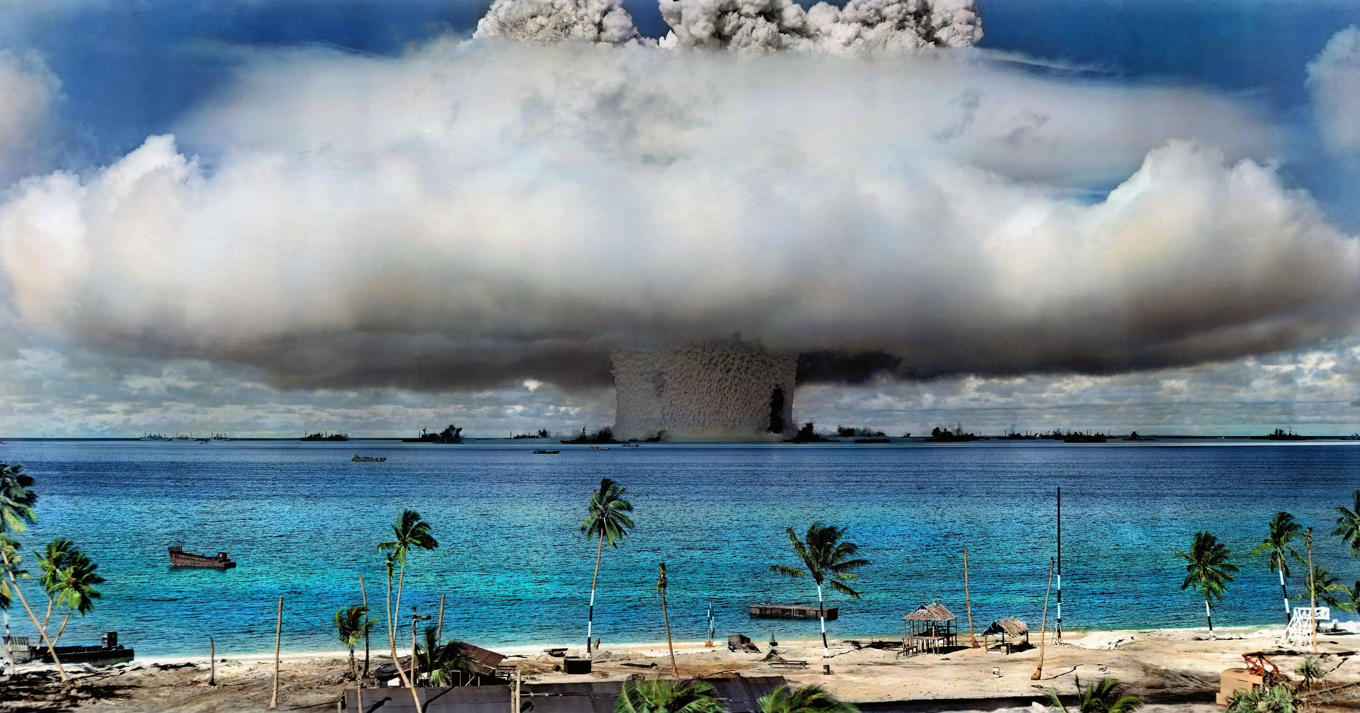
Cold War Policies

Slide 3
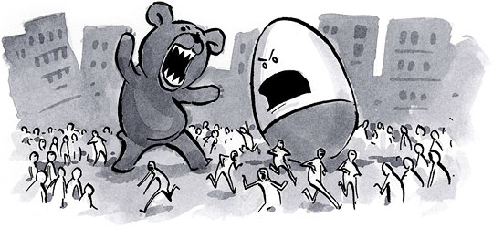
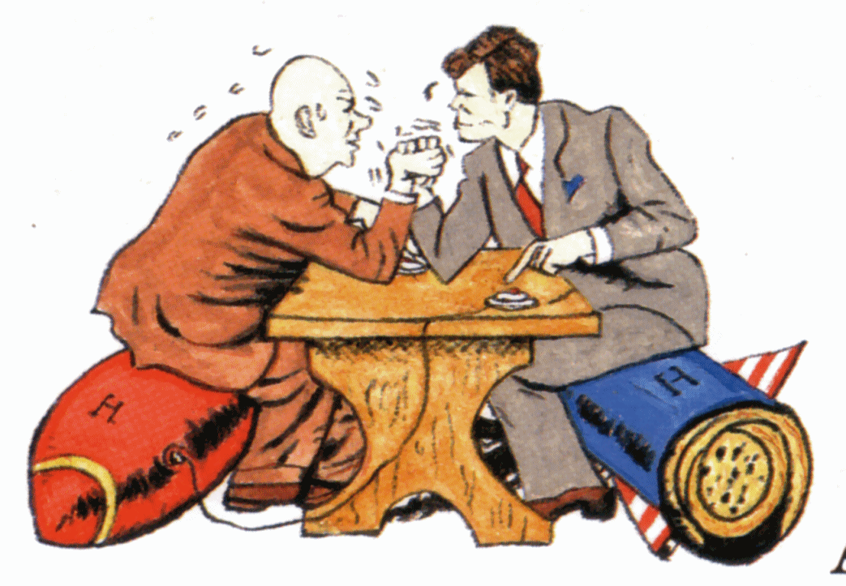
Cold War Policies
Policy Picture
Containment
Notes
Notes
Notes
Brinkmanship
Notes
Notes
Notes
Détente
Notes
Notes
Notes
Glasnotst
Revolution

Slide 4
I. Containment
Started by Pres. Truman
US will give economic & military aid to stop spread of communism
Aligns with domino theory

Slide 5
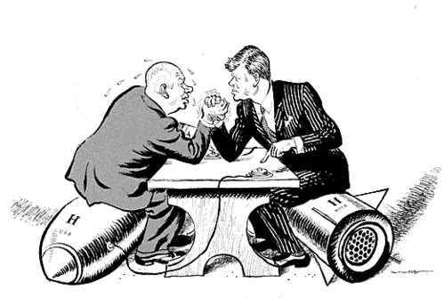
II. Brinkmanship
Pres. Eisenhower & Kennedy
Show that the US is willing to go to war
Like a game of chicken

Slide 6
III. Detente
Pres. Nixon & Regan
An easing of tensions in the 70’s & 80’s
More talks & treaties

Slide 7
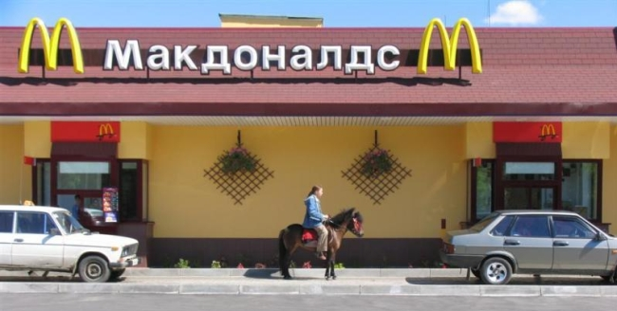
IV. Glasnost
Russian reforms
Some private companies (Perestroika)
More openness

Slide 8
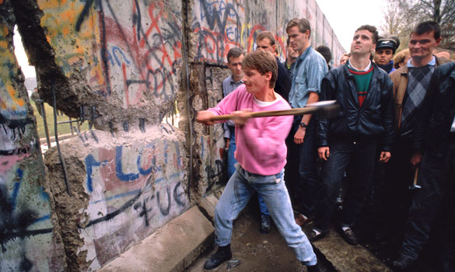
V. Revolution
Russian economy collapses
Satellite states break away
Berlin Wall torn down

Slide 9
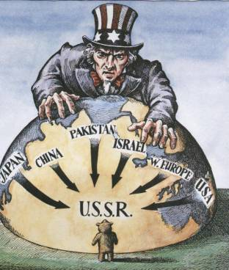
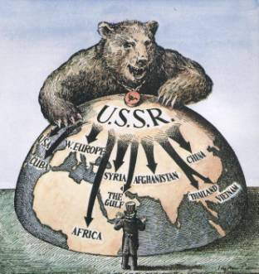
How we saw each other:

